Slide 1
CAP-790
Unit - I

Slide 2
Why Security?
Cyberspace (internet, work environment, intranet) is becoming a dangerous place for all organizations and individuals to protect their sensitive data or reputation. This is because of the numerous people and machines accessing it.
It is important to mention that the recent studies have shown a big danger is coming from internal threats or from disappointed employees like the Edward Snowden case, another internal threat is that information material can be easy accessible over the intranet.

Slide 3
Continue..
One important indicator is the IT skills of a person that wants to hack or to breach your security has decreased but the success rate of it has increased, this is because of three main factors −
Hacking tools that can be found very easily by everyone just by googling and they are endless.
Technology with the end-users has increased rapidly within these years, like internet bandwidth and computer processing speeds.
Access to hacking information manuals.

Slide 4
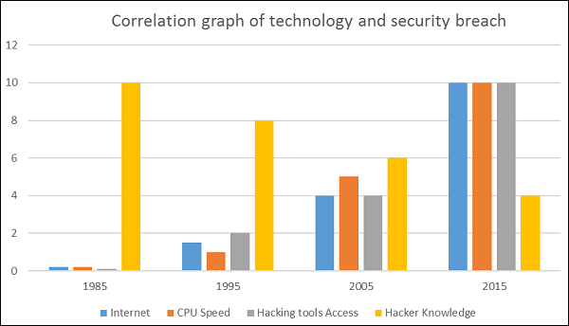
Security Breach

Slide 5
What is computer security?
Computer security basically is the protection of computer systems and information from harm, theft, and unauthorized use. It is the process of preventing and detecting unauthorized use of your computer system.
There are various types of computer security which is widely used to protect the valuable information of an organization.

Slide 6
What to Secure?
Let’s see this case, you are an IT administrator in a small company having two small servers staying in a corner and you are very good at your job. You are doing updates regularly, setting up firewalls, antiviruses, etc. One day, you see that the organization employees are not accessing the systems anymore. When you go and check, you see the cleaning lady doing her job and by mistake, she had removed the power cable and unplugged the server.
This case indicates that even physical security is important in computer security, as most of us think it is the last thing to take care of.

Slide 7
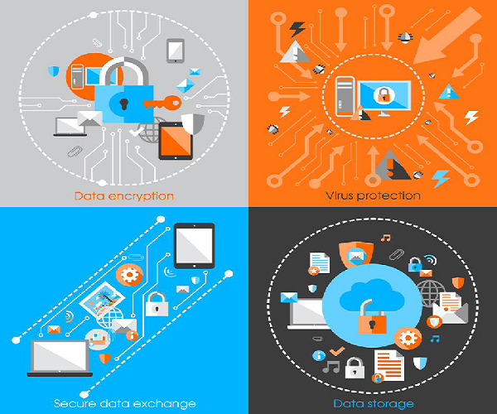
Continue..

Slide 8
What all to secure?
First of all, is to check the physical security by setting control systems like motion alarms, door accessing systems, humidity sensors, temperature sensors. All these components decrease the possibility of a computer to be stolen or damaged by humans and environment itself.
People having access to computer systems should have their own user id with password protection.
Monitors should be screen saver protected to hide the information from being displayed when the user is away or inactive.

Slide 9
Continue..
Secure your network especially wireless, passwords should be used.
Internet equipment as routers to be protected with password.
Data that you use to store information which can be financial, or non-financial by encryption.
Information should be protected in all types of its representation in transmission by encrypting it.

Slide 10
What is Computer Security
One way to ascertain the similarities and differences among Computer Security is by asking what is being secured. For example,
Information security is securing information from unauthorized access, modification & deletion
Application Security is securing an application by building security features to prevent from Cyber Threats such as SQL injection, DoS attacks, data breaches and etc.
Computer Security means securing a standalone machine by keeping it updated and patched
Network Security is by securing both the software and hardware technologies
Cybersecurity is defined as protecting computer systems, which communicate over the computer networks

Slide 11
Components of computer system
The components of a computer system that needs to be protected are:
Hardware, the physical part of the computer, like the system memory and disk drive
Firmware, permanent software that is etched into a hardware device’s nonvolatile memory and is mostly invisible to the user
Software, the programming that offers services, like operating system, word processor, internet browser to the user

Slide 12
The CIA Triad
Computer security is mainly concerned with three main areas:
Confidentiality is ensuring that information is available only to the intended audience
Integrity is protecting information from being modified by unauthorized parties
Availability is protecting information from being modified by unauthorized parties

Slide 13
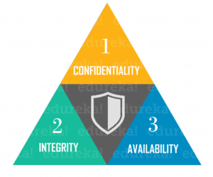
Continue..

Slide 14
Benefits of Computer Security Awareness
Do you know in all this digital world, what is the biggest hole or the weakest point of the security?
Most of the security breaches come from uninformed and untrained persons which give information to a third party or publish data in Internet without knowing the consequences.
See the following scenario which tells us what employees might end up doing without computer security awareness −

Slide 15
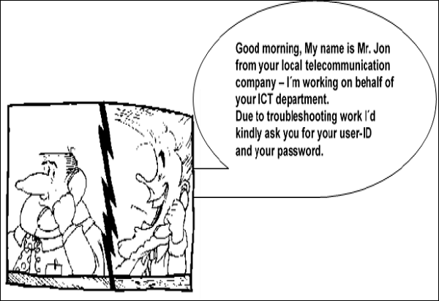
Continue..

Slide 16
Why is Computer Security Important?
In this digital era, we all want to keep our computers and our personal information secure and hence computer security is important to keep our personal information protected.
It is also important to maintain our computer security and its overall health by preventing viruses and malware which would impact on the system performance.

Slide 17
Potential Losses due to Security Attacks
Losing you data − If your computer has been hacked or infected, there is a big chance that all your stored data might be taken by the attacker.
Bad usage of your computer resources − This means that your network or computer can go in overload so you cannot access your genuine services or in a worst case scenario, it can be used by the hacker to attack another machine or network.

Slide 18
Continue..
Reputation loss − Just think if your Facebook account or business email has been owned by a social engineering attack and it sends fake information to your friends, business partners. You will need time to gain back your reputation.
Identity theft − This is a case where your identity is stolen (photo, name surname, address, and credit card) and can be used for a crime like making false identity documents.

Slide 19
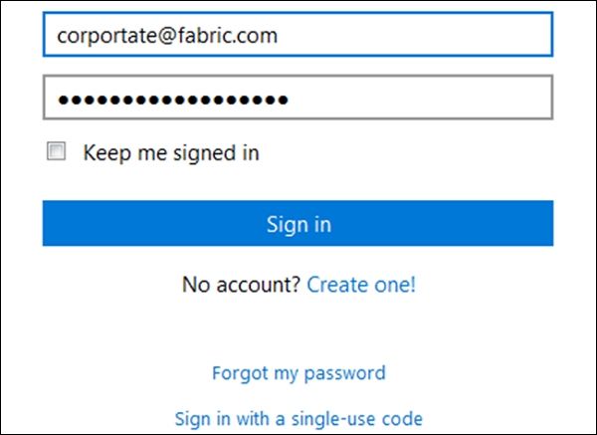
Continue..

Slide 20
Computer Security Practices
Computer security threats are becoming relentlessly inventive these days. There is much need for one to arm oneself with information and resources to safeguard against these complex and growing computer security threats and stay safe online. Some preventive steps you can take include:
Secure your computer physically by:
Installing reliable, reputable security and anti-virus software
Activating your firewall, because a firewall acts as a security guard between the internet and your local area network

Slide 21
Continue..
Stay up-to-date on the latest software and news surrounding your devices and perform software updates as soon as they become available
Avoid clicking on email attachments unless you know the source
Change passwords regularly, using a unique combination of numbers, letters and case types
Use the internet with caution and ignore pop-ups, drive-by downloads while surfing

Slide 22
Continue..
Taking the time to research the basic aspects of computer security and educate yourself on evolving cyber-threats
Perform daily full system scans and create a periodic system backup schedule to ensure your data is retrievable should something happen to your computer.

Slide 23
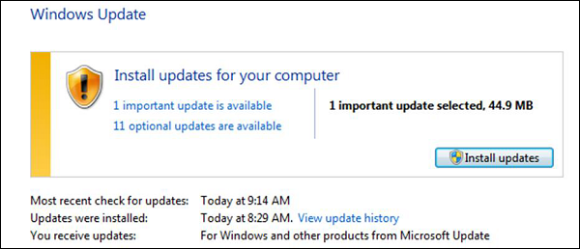
Basic Computer Security Checklist
Check if the user is password protected.
Check if the operating system is being updated.

Slide 24
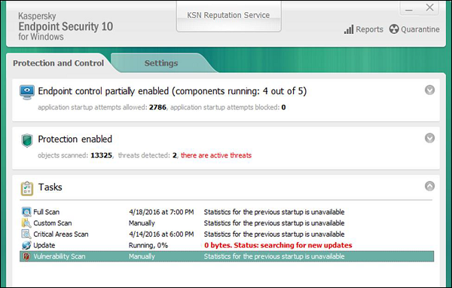
Continue..
Check if the antivirus or antimalware is installed and updated.

Slide 25
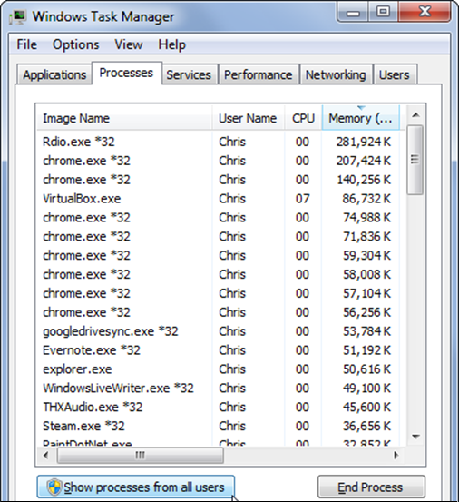
Continue..
Check for the unusual services running that consumes resources.

Slide 26
Continue..
Check if your monitor is using a screen saver.
Check if the computer firewall is on or not.
Check if you are doing backups regularly.
Check if there are shares that are not useful.
Check if your account has full rights or is restricted.
Update other third party software’s.

Slide 27
What is an information technology risk
If your business relies on information technology (IT) systems such as computers and networks for key business activities you need to be aware of the range and nature of risks to those systems.

Slide 28
Continue..
Risk is virtually anything that threatens or limits the ability of an organization to achieve its mission.
Risk Management should be a set of continuous and developing processes that are applied throughout an organization’s strategy and should methodically address all the risks surrounding past, present and future activities.

Slide 29
Continue..
The information security risks confronting an organization will vary with the nature of the processing performed by the organization and the sensitivity of the information processed.
An understanding of risk and the application of risk assessment methodology is essential to being able to efficiently and effectively create a secure computing environment.

Slide 30
General IT threats
hardware and software failure - such as power loss or data corruption
malware - malicious software designed to disrupt computer operation
viruses - computer code that can copy itself and spread from one computer to another, often disrupting computer operations
spam, scams and phishing - unsolicited email that seeks to fool people into revealing personal details or buying fraudulent goods
human error - incorrect data processing, careless data disposal, or accidental opening of infected email attachments.

Slide 31
Criminal IT threats
hackers - people who illegally break into computer systems
fraud - using a computer to alter data for illegal benefit
passwords theft - often a target for malicious hackers
denial-of-service - online attacks that prevent website access for authorised users
security breaches - includes physical break-ins as well as online intrusion
staff dishonesty - theft of data or sensitive information, such as customer details.

Slide 32
Real Risks
You will be a victim of Cybercrime
Your hard disk will suffer mechanical failure resulting in complete data loss
You computer will suffer an attack of computer disabling malicious software (viruses)
You will lose your computer to theft or damage from fire, flood or lightning strike
If you run a website, it will be hacked and used by people to perpetrate crimes
Your computer will breakdown at a very inconvenient time costing you large sums of money to fix when regular low cost computer maintenance could have prevented the issue.

Slide 33
Risk Management
Risk management is a process to identify and then manage threats which could severely impact or bring down the organization. Successful risk management needs the involvement of all levels of employers of an organization.
There are two main areas of focus for risk management, each with its own set of objectives.

Slide 34
Internal Factors
1. To reassure management that the business is aware of, and in control of, current and future business risks.
2. To safeguard business assets and reputation.
3. To help improve the business’s operating performance and shareholder value.
4. To improve efficiency by reducing risk exposure inherent in the business processes.
5. To support the achievement of strategic goals.

Slide 35
External Factors
1. To ensure compliance with regulatory requirements.
2. To deliver competitive advantage.
3. To reassure stakeholders and interest groups that the business is actively managing risk.

Slide 36
Steps involve in Risk Management
Risk management involves the following steps:
1. Reviewing operations of the organization.
2. Identifying potential threats to the organization.
3. The likelihood of their occurrence.
4. Adopting appropriate actions to address the most likely threats.

Slide 37
Risk Analysis
The way of risk assessment process may vary from one organization to other but the outline of the assessment work flow is as below:
1. Establish the Risk Assessment Team
2. Set the Scope of the Project
3. Identify Assets covered by the Assessment
4. Categorize Potential Losses
5. Identify Threats and Vulnerabilities
6. Identify existing Controls
7. Analyze the Data
8. Determine Cost-effective Safeguards
9. Report is to be Submitted

Slide 38
Information Security Requirements
Organizations today, like yours, understand the need for security. Failure to meet those business obligations can result in operational problems, impacting your organization’s ability to function, and could ultimately affect your bottom line.
Here are the 11 most common business obligations that you should keep in mind when determining your information security requirements:

Slide 39
Continue..
💼 1. Business Continuity
The largest obligation that businesses have regarding their information security requirements is the ability to provide continuity for business services in the event that business-as-usual is interrupted by an event (such as the COVID-19 pandemic). Any information security requirements should take business continuity into account.
🧔 2. End-User Security
End-user security is another important consideration. This includes end-user security awareness and training to limit end users’ exploitability and the ability to remediate any disruptions to end users.

Slide 40
Continue..
📝3. Risk Management
Information security risks (threats and vulnerabilities) must be identified, defined, quantified, and managed. This includes the prioritization and rating of the risks to systems and data.
🔒 4. Security Awareness
Your new information security program must raise the overall information security awareness of the organization, in order to ensure privacy and security issues are mitigated and given adequate respect and consideration.

Slide 41
Continue..
⛮ 5. Integration and Interoperability
The security program you put in place will require well-defined and mature processes and controls that support information security, privacy, and compliance management obligations.
🛡️ 6. Data Protection
The primary expectation is that sensitive or critical information is secured from unauthorized access and disclosure. However, this expectation drives more detailed expectations as well, such as proper access control, encryption, and threat management.

Slide 42
Continue..
💻 7. End-User Ease of Use
Security controls must be easy for end-users, being sure not to impede their ability to complete their duties. If it impedes their abilities, they’re less likely to comply.
⭐ 8. Innovation
The security strategy you implement must support innovative processes and enable the freedom to use new technologies.

Slide 43
Continue..
🔐 9. Confidence and Assurance
Security controls should support a high level of confidence and assurance to the organization that data is being protected by following industry standard best practices.
📋 10. Governance Transparency
There should be transparency related to security risks and capabilities, including communication of breach and security incident activity to senior management.
🖥️ 11. Project Management
Security analysis and design must be integrated into project management processes, ensuring a risk-based approach is followed while not unduly limiting the ability to initiate or finish projects.

Slide 44
Threat model
Threat modeling is a process by which potential threats, such as structural vulnerabilities or the absence of appropriate safeguards, can be identified, enumerated, and mitigations can be prioritized.
The purpose of threat modeling is to provide defenders with a systematic analysis of what controls or defenses need to be included, given the nature of the system, the probable attacker's profile, the most likely attack vectors, and the assets most desired by an attacker.

Slide 45
Continue..
Threat modeling answers questions like
“Where am I most vulnerable to attack?”
“What are the most relevant threats?”
and “What do I need to do to safeguard against these threats?”.

Slide 46
Continue..
Conceptually, most people incorporate some form of threat modeling in their daily life and don't even realize it.
Commuters use threat modeling to consider what might go wrong during the morning drive to work and to take preemptive action to avoid possible accidents.
Children engage in threat modeling when determining the best path toward an intended goal while avoiding the playground bully.
In a more formal sense, threat modeling has been used to prioritize military defensive preparations since antiquity.

Slide 47
Threat modeling methodologies for IT purposes
Conceptually, a threat modeling practice flows from a methodology. Numerous threat modeling methodologies are available for implementation.
Typically, threat modeling has been implemented using one of four approaches independently, asset-centric, attacker-centric, and software-centric.
Based on volume of published online content, the methodologies discussed below are the most well known.

Slide 48
STRIDE methodology
The STRIDE approach to threat modeling was introduced in 1999 at Microsoft, providing a mnemonic for developers to find 'threats to our products'. STRIDE, Patterns and Practices, and Asset/entry point were amongst the threat modeling approaches developed and published by Microsoft.
References to "the" Microsoft methodology commonly mean STRIDE and Data Flow Diagrams.

Slide 49
P.A.S.T.A.
The Process for Attack Simulation and Threat Analysis (PASTA) is a seven-step, risk-centric methodology.
It provides a seven-step process for aligning business objectives and technical requirements, taking into account compliance issues and business analysis.
The intent of the method is to provide a dynamic threat identification, enumeration, and scoring process.

Slide 50
Continue..
Once the threat model is completed security subject matter experts develop a detailed analysis of the identified threats.
Finally, appropriate security controls can be enumerated.
This methodology is intended to provide an attacker-centric view of the application and infrastructure from which defenders can develop an asset-centric mitigation strategy.

Slide 51
Trike
The focus of the Trike methodology is using threat models as a risk-management tool. Within this framework, threat models are used to satisfy the security auditing process.
Threat models are based on a “requirements model.” The requirements model establishes the stakeholder-defined “acceptable” level of risk assigned to each asset class.
Analysis of the requirements model yields a threat model from which threats are enumerated and assigned risk values.
The completed threat model is used to construct a risk model based on asset, roles, actions, and calculated risk exposure.

Slide 52
Generally accepted IT threat modeling processes
All IT-related threat modeling processes start with creating a visual representation of the application and / or infrastructure being analyzed.
The application / infrastructure is decomposed into various elements to aid in the analysis. Once completed, the visual representation is used to identify and enumerate potential threats.
Further analysis of the model regarding risks associated with identified threats, prioritization of threats, and enumeration of the appropriate mitigating controls depends on the methodological basis for the threat model process being utilized.

Slide 53
Continue..
The identification and enumeration of threats (or of mitigation objectives), can either be carried out in an attack-centric way or in an asset-centric way.
The former focuses on the types of possible attacks that shall be mitigated, whereas the latter focuses on the assets that shall be protected.

Slide 54
Visual representations based on data flow diagrams
The Microsoft methodology, PASTA, and Trike each develop a visual representation of the application-infrastructure utilizing data flow diagrams (DFD).
DFDs were developed in the 1970s as tool for system engineers to communicate, on a high level, how an application caused data to flow, be stored, and manipulated by the infrastructure upon which the application runs.
Traditionally, DFDs utilize only four unique symbols: data flows, data stores, processes, and interactors.

Slide 55
Continue..
In the early 2000s, an additional symbol, trust boundaries, were added to allow DFDs to be utilized for threat modeling.
Once the application-infrastructure system is decomposed into its five elements, security experts consider each identified threat entry point against all known threat categories.
Once the potential threats are identified, mitigating security controls can be enumerated or additional analysis can be performed.

Slide 56
Inadequate security
Inadequate security is often the cause of personal injuries to individuals. These injuries can be devastating and life-changing.
Inadequate security can happen:
In nursing homes or assisted living facilities
At shopping malls
On public transportation
At a hotel
At a college
In parking garages and parking lots
At an ATM machine

Slide 57
Continue..
Businesses are required to provide you with adequate and necessary security for your safety.
They have the legal responsibility to maintain a safe situation or to warn visitors of potentially dangerous conditions.
Inadequate security claims concern legal liability imposed on business and property owners for foreseeable actions of others which cause harm.
It happens when an individual is attacked or victimized by a third party. Sometimes it is the result of inadequate lighting in a parking lot or a hotel providing an inadequate or defective locking system.

Slide 58
Continue..
Inadequate security is negligence and lawsuits resulting from this are also referred to as premise liability claims. The victim claims that something happened to him or her on the premises of a business that could have been prevented if there had been better security in place.
If there were things that the business or property owner could have done – should have done – to prevent the incident, the victim may be able to hold them legally responsible for their injuries.
If businesses and/or property owners want your patronage, they should look after your security. If they fail to do so, and you are the victim of a crime, you have grounds for a lawsuit.

Slide 59
Access Control
Access control is a method of restricting access to sensitive data. Only those that have had their identity verified can access company data through an access control gateway.

Slide 60
Components of Access Control
Authentication: The act of proving an assertion, such as the identity of a person or computer user. It might involve validating personal identity documents, verifying the authenticity of a website with a digital certificate, or checking login credentials against stored details.
Authorization: The function of specifying access rights or privileges to resources. For example, human resources staff are normally authorized to access employee records and this policy is usually formalized as access control rules in a computer system.

Slide 61
Continue..
Access: Once authenticated and authorized, the person or computer can access the resource.
Manage: Managing an access control system includes adding and removing authentication and authorization of users or systems. Some systems will sync with G Suite or Azure Active Directory, streamlining the management process.
Audit: Frequently used as part of access control to enforce the principle of least privilege. Over time, users can end up with access they no longer need, e.g. when they change roles. Regular audits minimize this risk.

Slide 62
How Does Access Control Work?
Access control can be split into two groups designed to improve physical security or cybersecurity:
Physical access control: limits access to campuses, building and other physical assets, e.g. a proximity card to unlock a door.
Logical access control: limits access to computers, networks, files and other sensitive data, e.g. a username and password.

Slide 63
Continue..
For example, an organization may employ an electronic control system that relies on user credentials, access card readers, intercom, auditing and reporting to track which employees have access and have accessed a restricted data center.
This system may incorporate an access control panel that can restrict entry to individual rooms and buildings, as well as sound alarms, initiate lockdown procedures and prevent unauthorized access.

Slide 64
Why is Access Control Important?
Access control minimizes the risk of authorized access to physical and computer systems, forming a foundational part of information security, data security and network security.
Depending on your organization, access control may be a regulatory compliance requirement:

Slide 65
Continue..
PCI DSS: Requirement 9 mandates organizations to restrict physical access to their buildings for onsite personnel, visitors and media, as well as having adequate logical access controls to mitigate the cybersecurity risk of malicious individuals stealing sensitive data. Requirement 10 requires organizations employ security solutions to track and monitor their systems in an auditable manner.

Slide 66
Continue..
HIPAA: The HIPAA Security Rule requires Covered Entities and their business associates to prevent the unauthorized disclosure of protected health information (PHI), this includes the usage of physical and electronic access control.

Slide 67
Continue..
SOC 2: The auditing procedure enforce third-party vendors and service providers to manage sensitive data to prevent data breaches, protecting employee and customer privacy.
Companies who wish to gain SOC 2 assurance must use a form of access control with two-factor authentication and data encryption. SOC 2 assurance is particularly important for organization's who process personally identifiable information (PII).

Slide 68
Continue..
ISO 27001: An information security standard that requires management systematically examine an organization's attack vectors and audits all cyber threats and vulnerabilities. It also requires a comprehensive set of risk mitigation or transfer protocols to ensure continuous information security and business continuity.

Slide 69
What are the Types of Access Control?
Attribute-based access control (ABAC): Access management systems were access is granted not on the rights of a user after authentication but based on attributes. The end user has to prove so-called claims about their attributes to the access control engine. An attribute-based access control policy specifies which claims need to be satisfied to grant access to the resource.
For example, the claim may be the user's age is older than 18 and any user who can prove this claim will be granted access. In ABAC, it's not always necessary to authenticate or identify the user, just that they have the attribute.

Slide 70
Continue..
Discretionary access control (DAC): Access management where owners or administrators of the protected system, data or resource set the policies defining who or what is authorized to access the resource. These systems rely on administrators to limit the propagation of access rights. DAC systems are criticized for their lack of centralized control.

Slide 71
Continue..
Mandatory access control (MAC): Access rights are regulated by a central authority based on multiple levels of security. MAC is common in government and military environments where classifications are assigned to system resources and the operating system or security kernel will grant or deny access based on the user's or the device's security clearance. It is difficult to manage but its use is justified when used to protected highly sensitive data.

Slide 72
Continue..
Role-based access control (RBAC): In RBAC, an access system determines who can access a resource rather than an owner. RBAC is common in commercial and military systems, where multi-level security requirements may exist. RBAC differs from DAC in that DAC allows users to control access while in RBAC, access is controlled at the system level, outside of user control. RBAC can be distinguished from MAC primarily by the way it handles permissions.

Slide 73
Continue..
Rule-based access control: A security model where an administrator defines rules that govern access to the resource. These rules may be based on conditions, such as time of day and location. It's not uncommon to have some form of rule-based access control and role-based access control working together.

Slide 74
Continue..
Break-Glass access control: Traditional access control has the purpose of restricting access, which is why most access control models follow the principle of least privilege and the default deny principle. This behavior may conflict with operations of a system. In certain situations, humans are willing to take the risk that might be involved in violating an access control policy, if the potential benefit of real-time access outweighs the risks. This need is visible in healthcare where inability to access to patient records could cause death.

